Slide 1

Team
Pacman
- Milestone 3 -

Slide 2
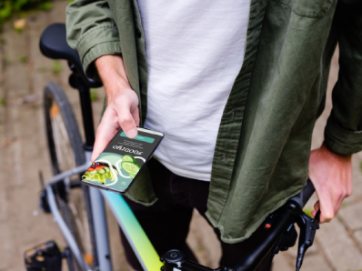
Style guide
Design changes
Our coding process
LoFi HTML Prototype
Qualitative Evaluation
What needs to be done
Time to discuss
AGENDA
Notes:
Our HMW question

Slide 3

FOODIYO
- discover new recipes -
The goal of the app is for people to discover new recipes with the ingredients they have already at home.
App designed for everybody, but more focused on the youth.
Possibility to choose your ingredients and select different food/diet types.

Slide 4
How might we support young people in finding recipe inspirations with ingredients they already have at home
to prepare great dishes?
Notes:
Our HMW question

Slide 5


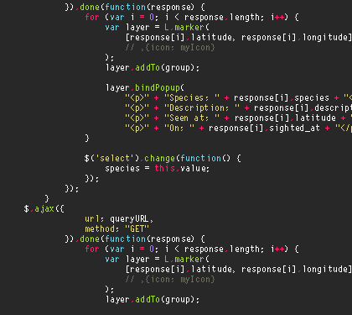
what happened since milestone 2…
…coding, coding, coding…
https://giphy.com/gifs/rock-coding-programming-MdA16VIoXKKxNE8Stk https://giphy.com/gifs/code-coding-seamless-xT9IgzoKnwFNmISR8I

Slide 6
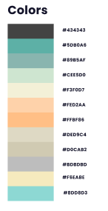
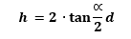
style guide
Design language → own customized design language
color scheme:
font sizes:
→ minimum: 7pt
→ recommended: 10pt
*Figma Prototype

Slide 7
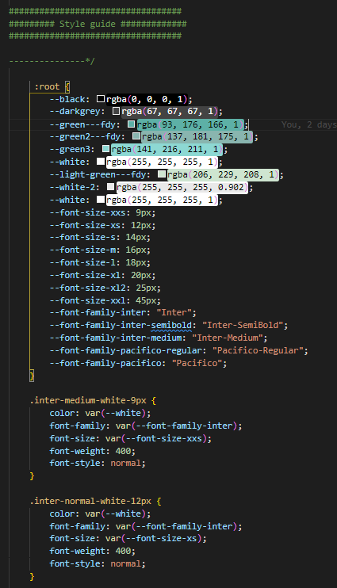
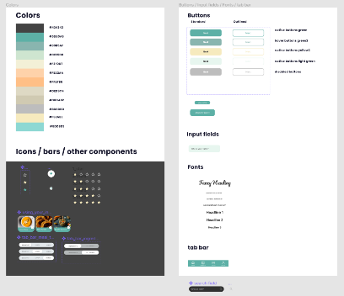
style guide
*css

Slide 8
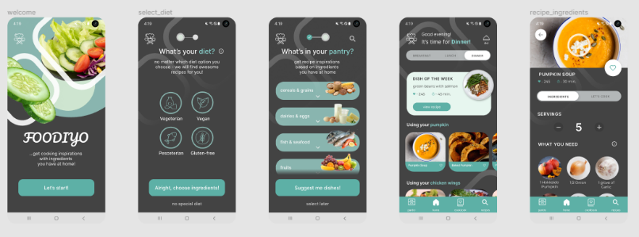
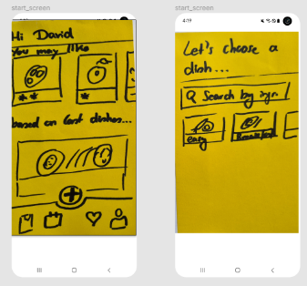
HiFi Prototype

Slide 9
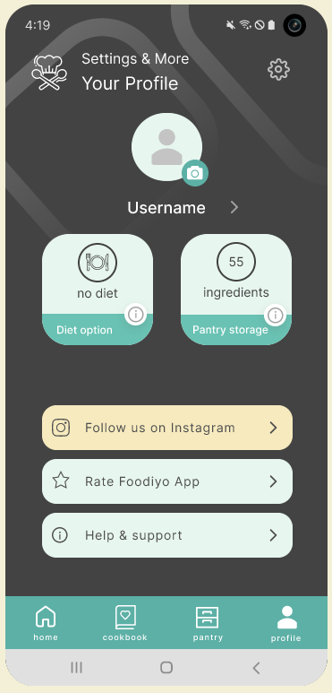
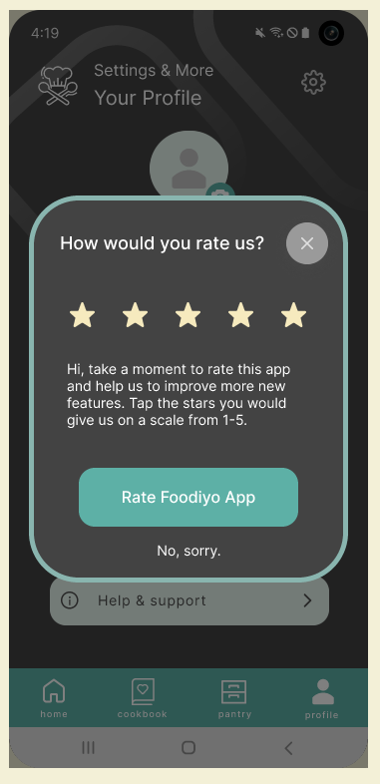
design changes
created a user section where the user can set personal preferences (e.g. change diet settings & user name)
included a rating option: of course 5 stars for FOODIYO :)
*Figma Prototype

Slide 10
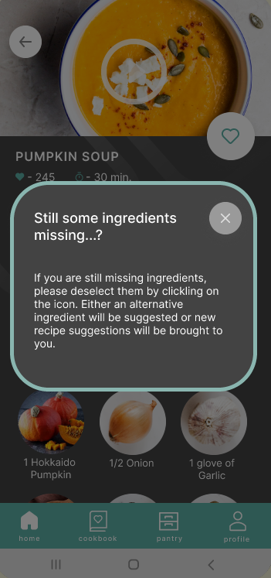
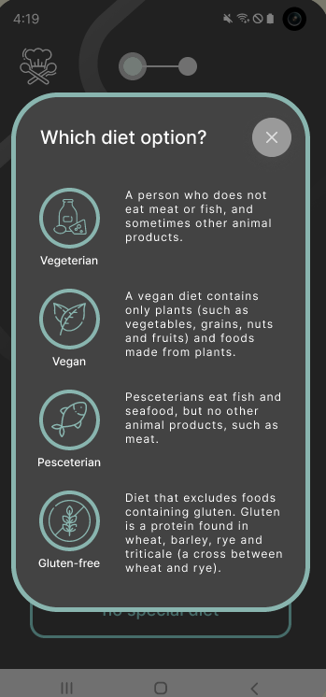
design changes
added more “help functions” which support the user in getting information about a specific function
*Figma Prototype

Slide 11
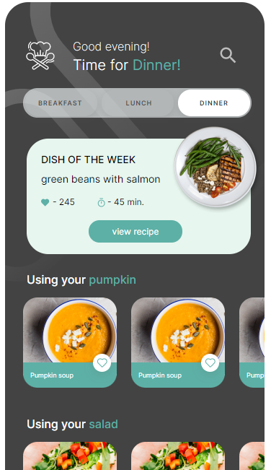
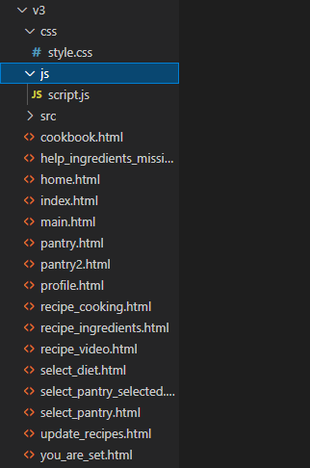

Who needs a framework? ;)
We did it the traditional way …
*HTML Prototype
Notes:
maybe add problems that occured (simultaneous working etc.)

Slide 12

LoFI HTML Prototype
Open this link in your Browser or on your Smartphone (Google Chrome if possible):
https://juliamgdln.github.io

Slide 13
Qualitative Evaluation
“In my pantry storage I would prefer getting a short overview with all my ingredients without scrolling!”
“I do not need a video!”
“How can I search for ingredients / recipes? The search function seems to be broken…?”
“I really like the recipe screen, the possibility to adapt servings at the beginning is great!”
“What does ‘suggest ingredient’ mean and what’s the function behind it?
“I like the pictures of the dishes! Also, it is nice to have a “dish of the week!”

Slide 14
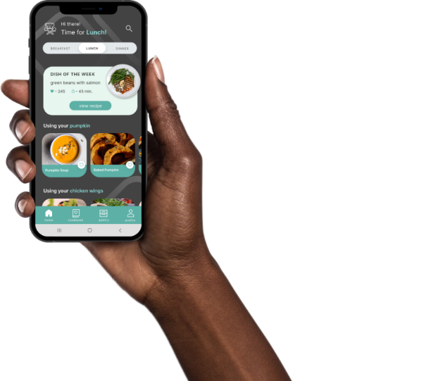
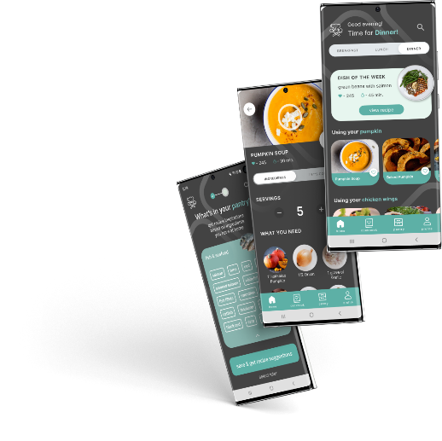
what needs to be done..
JavaScript:
animations
like function: save favs in “cookbook”
pantry: save ingredients
user profile: change diet & save it

Slide 15
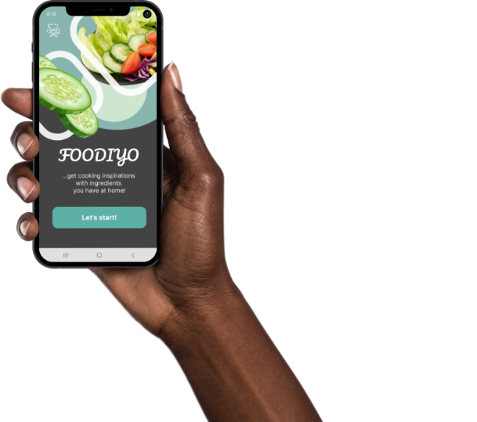
thanks for your attention!
Looking forward for your feedback :)
*created by Julia & Chrissi

